Slide 1

Authorship Analysis Using Impostors Method Capstone Project Phase 2
By: Raz Itzhak Afriat, Konstantin Maltcev
Supervisors: Dr. Renata Avros, Prof. Zeev Volkovich
Notes:
Hello everyone, my name is Kostya Maltcev and...
Our supervisors are Renata Avros and Zeev Volkovich
And our project is about Authorship Analysis using the Impostors Method

Slide 2
Plagiarism
Definition – The act of passing off ideas or texts of another as one's own
A form of theft – The credits belongs to the genuine author
Hard to prove – The same lexicon is not an evidence
In this project, A known series “And Quite Flows the Don” of A. Sholokhov is being investigated as suspected
Notes:
So, a short intro.
We all know well what plagiarism is by definition and lots of struggles it brings to ours lives
Many famous writers were accused in plagiarism, but it’s very hard to prove

Slide 3
Related Work
Koppel, Moshe & Winter, Yaron (2014) – Used and tested Impostors Method
Analyzed blog pairs
Compared different classification techniques
Tested several ways of using Impostors Method
Z. Volkovich (2020) – Novel approach to solve the task of the General Authorship Attribution problem
Investigates medieval Arabic documents
Produced evaluations for two manuscripts, questionably attributed to Abu Hamid Al Ghazali.
Used a “Tweets Approach”, dividing documents into “tweets” and analyzing them using deep learning methods
Notes:
We based on the previous work’s of Zeev where he used the tweets approach to the similar problem in Arabic texts
And Moshe Koppel, which tested the Impostors method in his work

Slide 4
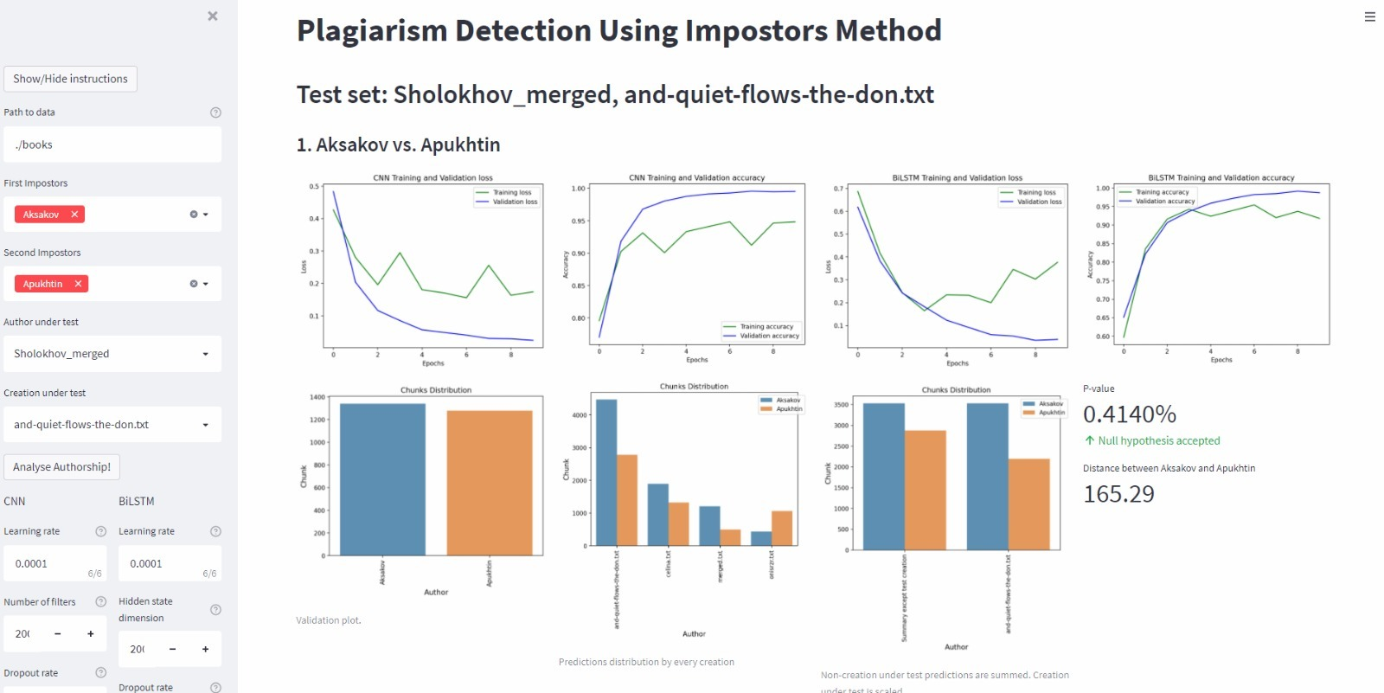
The solution - Plagiarism Detection Model
We propose a literature’s authorship evaluation system based on Impostors’ method approach, and a CNN/Bi-LSTM model accompanied, providing a web-based interface
Notes:
And finally, we have built our Plagiarism Detection Tool
It contains an easy to use web-based Graphical Interface and very strong CNN-BiLSTM Ensemble model

Slide 5
Impostors Method
Iterative algorithm with promising results
Input of each iteration – Creations of a pair of authors
The method evaluates similarity of a given text to the impostors
Testing with the accused author’s genuine work alongside the questionable one.
A connection between texts in the tested collection is going to indicate real and fabricated creations
Notes:
So, a bit about what Impostors’ method is:
Basically impostor it’s an another author with his genuine creations
Our input is two Impostors
And our output is classification of all the given works of accused author and his accused creation
We also assume that other his works are genuine

Slide 6
Libraries and Frameworks
TensorFlow – A well known library designed for building ML models
MLxtend – A library of useful tools for the day-to-day data science tasks.
dtaidistance - Library for calculating Dynamic Time Warping distance, used for constructing the differences between impostors’ data.
statsmodels – Used for calculating the P-Value of the results observations
Streamlit – Library for building and deploying web apps with python scripts.
Notes:
I'll give a short overview on libraries we used:
Tensorflow and Keras were used to build our model from a scratch
Mlxtend was used to built an Ensemble model
Dtaidistance is an open-source library for calculating DTW distance between impostors
statsmodel library was used to compute the z-test and p-value
And finally Streamlit is an awesome library to build Graphical Interfaces for Data Science needs

Slide 7
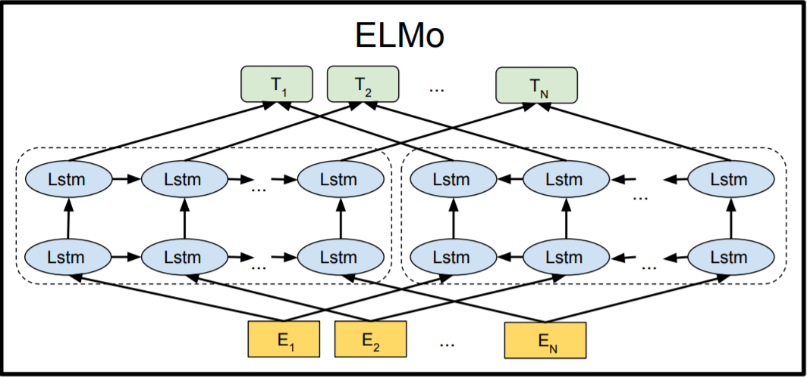
Preprocessing and Embedding
Preprocessing with NLTK & pymystem3 – Handles efficiently Russian documents
stemming, tokenizing, parsing etc.
Dividing the documents to short “Tweets”
Taking the “Tweets approach” to analyze short-patterns in the text
Embedding with the ELMo method
RusVectōrēs – Elmo implementation designed and pretrained on Russian corpora
Takes into consideration the context meaning
ELMo is a word embedding method for representing a sequence of words as a corresponding sequence of vectors.
Notes:
NLTK and PyMystem3 were used for text preprocessing and for embedding we used ELMo with RusVectores model, pre-trained on over 10 billion words
ELMo well known architecture which takes in account the context meaning and fits our task very well.

Slide 8
Dynamic Time Wrapping Distance
In DL, it is vital to being able to meaningfully measure the similarity of data objects
Simply calculating the Euclidian distance will not do:
The series might be of different lengths
They may not be in perfect sync
Dynamic Time Wrapping (DTW) Distance is used as a measure between two “Time series” with different lengths
Constructing artificial time series out of texts
Analyzing the time series using DTW

Slide 9
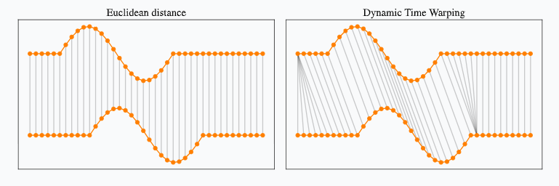
Dynamic Time Wrapping Distance
Finds a non-linear matching of points of two time series.
The matching is equivalent to stretching (compressing) the time series in the X-axis
Notes:
Raz

Slide 10
Ensemble Model
Need to classify the questionable creation into either of the impostors
An Ensemble model of CNN/LSTM is used to learn the authors
Soft voting - Summing the predicted probabilities and predicting the class label with the largest sum probability.
Pros:
Low Variance – Less sensitive to inputs to the learning feature
High Accuracy – One model is not always enough to fit the entire training data.
Cons:
Slow – More models working together means more computations needed
Notes:
Raz

Slide 11
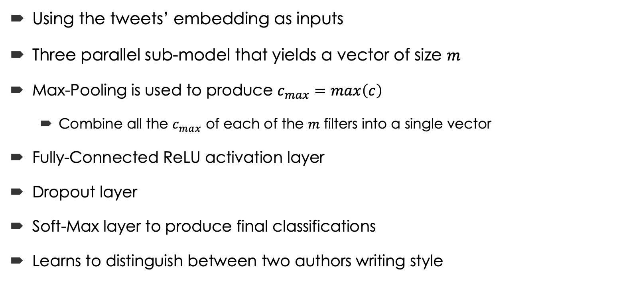
The CNN Model
Using the tweets’ embedding as inputs
Three parallel sub-model that yields a vector of size $m$
Max-Pooling is used to produce $c_{max}=max\left(c\right)$
Combine all the $c_{max}$ of each of the $m$ filters into a single vector
Fully-Connected ReLU activation layer
Dropout layer
Soft-Max layer to produce final classifications
Learns to distinguish between two authors writing style
Notes:
So, our CNN model based on three parallel sub-models where the input is embeddings of the tweets.
Each word in embedding is the vector of size 1024.
Imagine we have 2000 words in some text, and our chunk-size is 200, as input we get tensor with shape of (10, 200, 1024), where 10 is the number of chunks, each chunk has 200 words and each word is a vector of size 1024

Slide 12
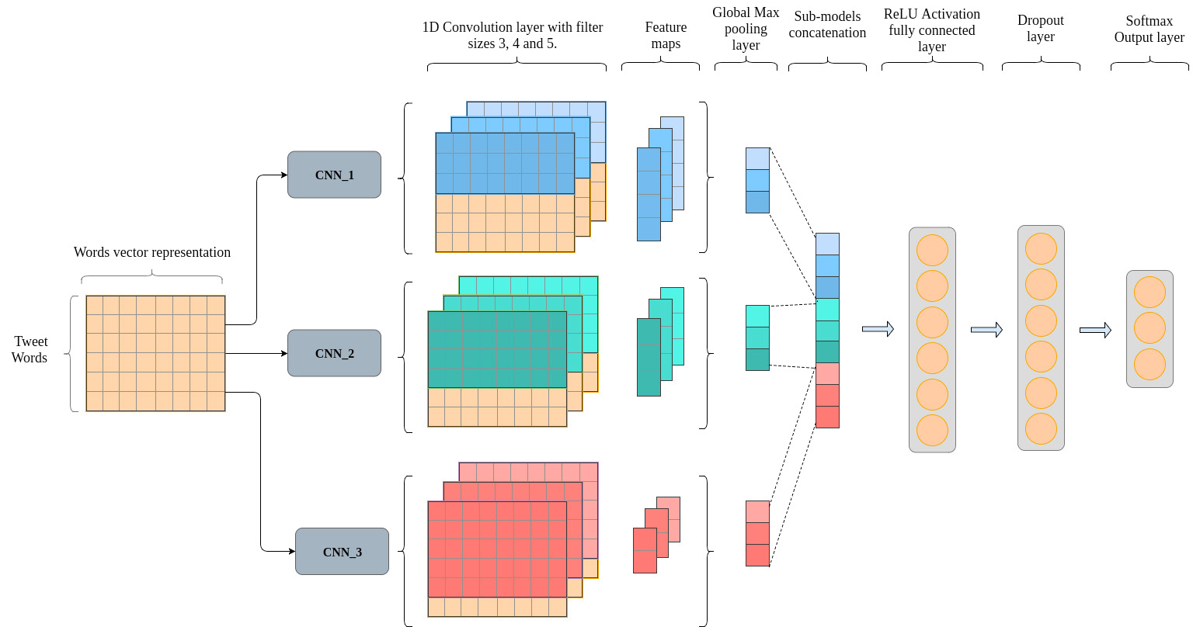
The CNN Model
Notes:
Then, feature maps are passed to the max-pooling layer
Fully-connected layer has an ReLU activation function Dropout layer ignores some of the weights according the the ratio
And Soft-Max layer produces final chunks classifications

Slide 13
The Bi-LSTM Model
Simple RNN is not suitable for long dependences
One directional LSTM does not consider post-word information
Bi-LSTM, or two-directional solves this matter
Is not prone to suffer from the Vanishing Gradient problem
Notes:
Raz

Slide 14

The Bi-LSTM Model
The chunks are passed to each layer of the LSTMs
The two generates a vector of size $2h$ (LSTM size)
Dropout layer (First)
ReLU activation fully connected layer
Dropout layer (Second)
Soft-Max layer
Notes:
Raz

Slide 15
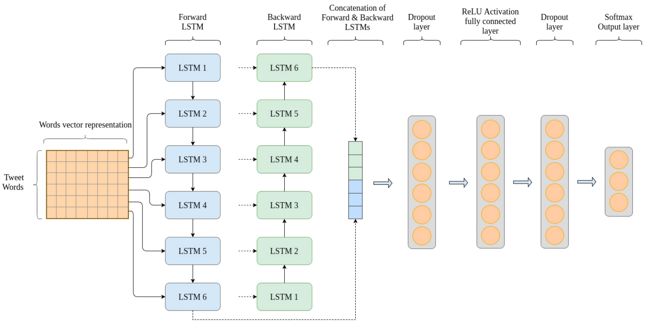
The Bi-LSTM Model
Notes:
Raz

Slide 16
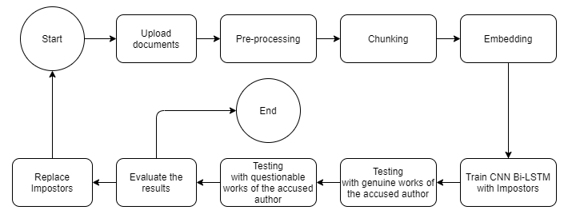
System’s Flow
Notes:
Raz

Slide 17
Suggested Initial Parameters
CNN:
Bi-LSTM:
Hyper-parameter | Value
Filter sizes | [3, 4, 5]
Number of filters | 200
Number of units in fully connected layer | 30
Dropout rate | 0.5
Learning rate | 0.0001
Number of epochs | 20
Batch size | 50
Hyper-parameter | Value
LSTM hidden state dimension | 200
Number of units in fully connected layer | 30
Dropout rate | 0.5
Learning rate | 0.0001
Number of epochs | 20
Batch size | 50
Notes:
Raz

Slide 18
Performance Evaluation of the System
Monitoring the networks performances reports.
Monitoring loss and accuracy values
Monitoring final predictions
“Impostors’ proximity measure” to evaluate data quality.
Previously tested and accepted components will not be tested
Notes:
Raz

Slide 19
Test Cases:
Test Case | Input | Expected Result
Case A | A genuine work of the accused author | Classified together with most of the tested texts
Case B | Plagiarism | Recognized as an anomaly
Case C | A partially plagiarized text | Classified the same as most of the other texts with a low or medial probability
Notes:
Raz

Slide 20
The Application/GUI
Easy experiments committing
Full control over the system parameters& configurations
Detailed, visual results in plots and Streamlit metrices
Single-paged - easy to operate
https://drive.google.com/file/d/1y4u0PxydkVnQSlVZlYOAni0MqB8XKGCO/view
Notes:
As I’ve said before, GUI was built for an easy use of researcher, it allows multiple experiments at the time, shows every result needed for analysis and very easy to modify
Let’s see how the process looks like
(turn on video)

Slide 21
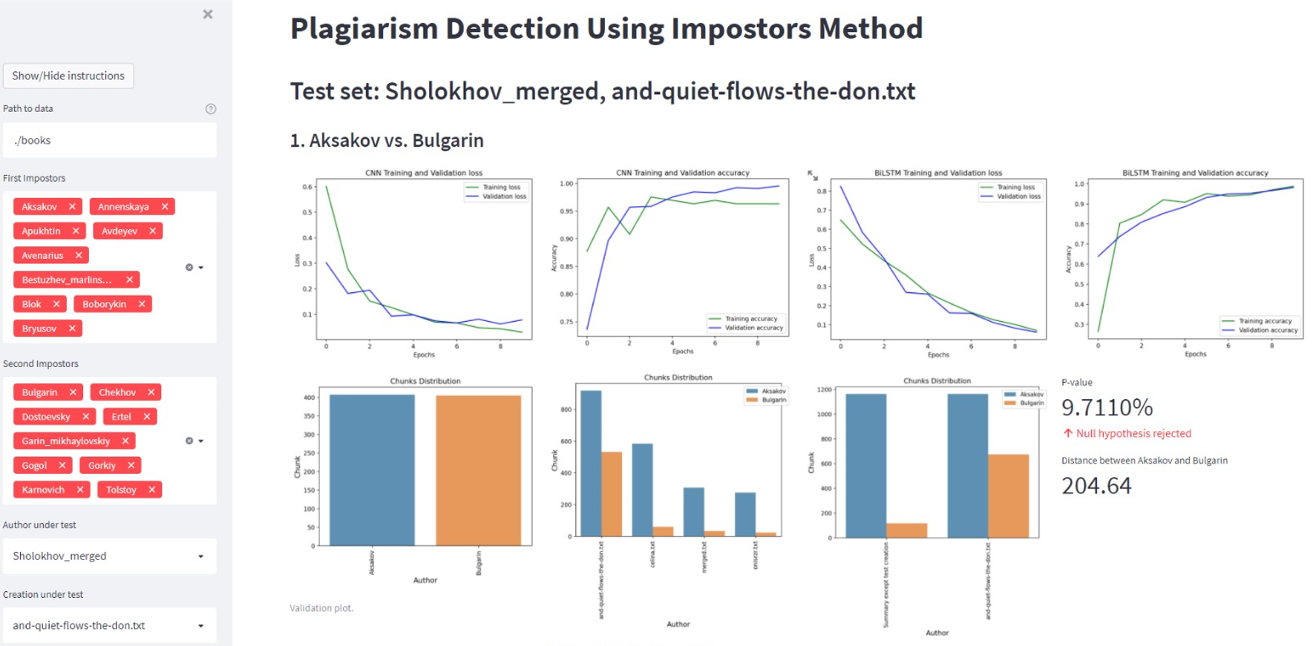
The GUI – Side bar
Simply direct the system to the texts
Choose first list of impostors
Choose the second list
Select author to test
Select the specific creation
Notes:
Take a closed look at our sidebar, where we could get help, adjust impostors, author and creation under test and also adjust hyperparameters for the networks

Slide 22
The GUI – Page body
Detailed results, performance reports and predictions
Notes:
And this is the main screen, we can see the results of trained networks, their accuracy and loss
This is an validation plot
This one is accused author chunks distribution
And this one shows the difference between genuine and accused works of the author under test
At the end we may finally see the P-value and the distance
Here I want to citate one of the Lecturers at GoogleAI:
The p-value doesn’t prove anything.
It’s just a way to use the suddenness as the basis for an intelligent decision.
- Cassie Kozyrkov

Slide 23
References
el Mostafa, Hambi & Benabbou, Faouzia. (2020). A deep learning based technique for plagiarism detection: a comparative study. IAES International Journal of Artificial Intelligence (IJ-AI). 9. 81. 10.11591/ijai.v9.i1.pp81-90.
Volkovich, Zeev. (2020). A Short-Patterning of the Texts Attributed to Al Ghazali: A “Twitter Look” at the Problem. Mathematics. 8. 10.3390/math8111937.
Heikal, Maha & Torki, Marwan & El-Makky, Nagwa. (2018). Sentiment Analysis of Arabic Tweets using Deep Learning. Procedia Computer Science. 142. 114-122. 10.1016/j.procs.2018.10.466.
Kim, Yoon. (2014). Convolutional Neural Networks for Sentence Classification. Proceedings of the 2014 Conference on Empirical Methods in Natural Language Processing. 10.3115/v1/D14-1181.
Cliche, Mathieu. (2017). BB_twtr at SemEval-2017 Task 4: Twitter Sentiment Analysis with CNNs and LSTMs. 573-580. 10.18653/v1/S17-2094
Sepp Hochreiter and Jürgen Schmidhuber. 1997. Long Short-Term Memory. Neural Comput. 9, 8 (November 15, 1997), 1735–1780. DOI:https://doi.org/10.1162/neco.1997.9.8.1735.
Koppel, Moshe & Winter, Yaron. (2014). Determining If Two Documents Are Written by the Same Author. Journal of the Association for Information Science and Technology. 65. 10.1002/asi.22954.
D. R. Baymurzina, D. P. Kuznetsov, and M. S. Burtsev, ‘‘Language model embeddings improve sentiment analysis in Russian,’’ in Proc. Int. Conf. Dialogue Comput. Linguistics Intell. Technol., vol. 18, 2019, pp. 53–63.
Notes:
Kostya

Slide 24

Thanks!
24

